Slide 1

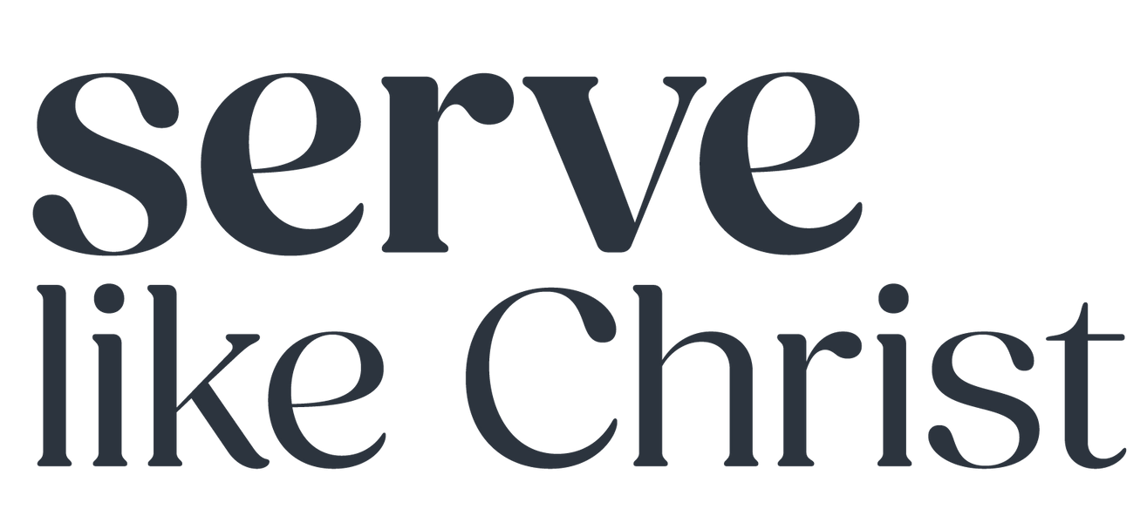
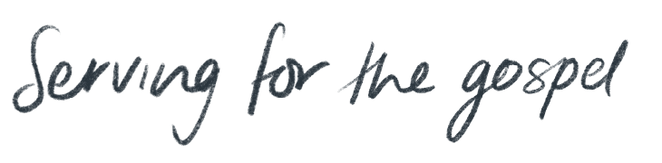


Slide 2
Engage All Generations
A Paradigm shift

Slide 3
VALUE
Everyone has value and all believers are part of God’s family.
Gen 1:26-27; Matt 19:13-15; Mark 10:13-16; Rom 12:3-8; Acts 16:31-33; Luke 8:19-21; 1 Cor 12:12-27
FAMILY
Family is the means through which faith is passed along.
Deut 29:10-12, 31:12-13; Jos 8:34-35; 2Chron 20:13; Neh 8:2-3, 12:43; Acts 2:46-47, 4:32-35, 21:5-6.
RESPONSIBILITY
We all have a responsibility for growing each other’s faith.
Deut 6:1-9; Psalm 145:4; Ps 78 1-8; Exo 12:24-28, 13:14; Tit 2:1-15

Slide 4
“All authority in heaven and on earth has been given to me. Therefore, go and make disciples of all nations, baptising them in the name of the Father and of the Son and of the Holy Spirit and teaching them to obey everything I have commanded you.”
Matthew 28: 18-20

Slide 5


Slide 6
Take a moment to think about the people who have helped form your faith throughout your lifetime.
Who among them were from a different generation that yours? Were they older or younger than you?
How did your relationships with these people matter to your faith formation?

Slide 7


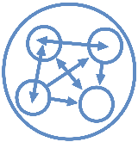
Multi-generational - tolerance living alongside superficial and polite interaction
Cross-generational - genuine relationship, little individual or collective transformation
Inter-generational - mutuality, equality and reciprocity are the guiding values, leading to both individual and collective transformation

Slide 8
Intergenerational ministry occurs when a congregation intentionally brings the generations together in mutual serving, sharing or learning within the core activities of the church in order to live out being the body of Christ to each other and the greater community.
Holly Allen, Christine Lawton Ross

Slide 9
Paradigm Shifts
‘Adults and children’ Church Community
Intentional

Slide 10
Intergenerational ministry occurs when a congregation intentionally brings the generations together in mutual serving, sharing or learning within the core activities of the church in order to live out being the body of Christ to each other and the greater community.
Holly Allen, Christine Lawton Ross

Slide 11
How do we be intentional?
Language
Environment
Practices

Slide 12
As you reflect on your experience of church what do you notice about how the ages are separated or together?
How could you move from an Adult/Child mindset toward a Church Community mindset?

Slide 13
Paradigm Shifts
‘Adults and children’ Church Community
Intentional
Teachers and Learners’ Disciples
Mutual

Slide 14
Think about a time when you were surprised to learn something from someone that you didn’t expect to.
It may be someone younger or it may be in a different power imbalance situation.
Share with the person next to you

Slide 15
Paradigm Shifts
‘Adults and children’ Church Community
Intentional
‘Teachers and Learners’ Disciples
Mutual
‘Worship and Learning’ Life Together
Core Activities

Slide 16
Intergenerational ministry occurs when a congregation intentionally brings the generations together in mutual serving, sharing or learning within the core activities of the church in order to live out being the body of Christ to each other and the greater community.
Holly Allen, Christine Lawton Ross

Slide 17
What core activities in your context are all ages engaged in?
What tweaks could you make to engage more generations in more core activities?

Slide 18
Books and Resources
Intergenerational Christian Formation, by Holly Catterton Allen, Christie Lawton Ross and Cory Seibel
Being an intergenerational church: practices to bring the generations back together, by Suzi Farrant and Daren Philip
Engage All Generations , edited by Holly Allen
All Ages Becoming, edited by Cory Seibel
A Gospel for all ages, by David Csinos
Being an intergenerational church papers - A Series of short 1-2 page summaries of various aspects of intergenerational ministry
https://www.intergenerate.com.au/ -Lots of great resources, links and
videos

